Slide 1

Distance Estimation from Single Camera
Project guide – Abhilash S
Group-3
Rishabh Chaturvedi
Yash Chaudhary
Raju Santhani

Slide 2
Problem statement
In many real-world applications like autonomous driving (Object detection and collision avoidance), it's crucial to know the distance to objects in the environment for safe and effective navigation.
Estimating distance from a single 2D image is challenging because:
Loss of Depth Information
Complex Scene Structures
Dynamic Scenarios
Objective
To develop and implement a model capable of accurately estimating the distance to objects in a scene using live video feed captured by a single camera.
The specific objectives include:
Real-Time Object Detection
Accurate Distance Estimation Using Bounding Box Dimensions

Slide 3
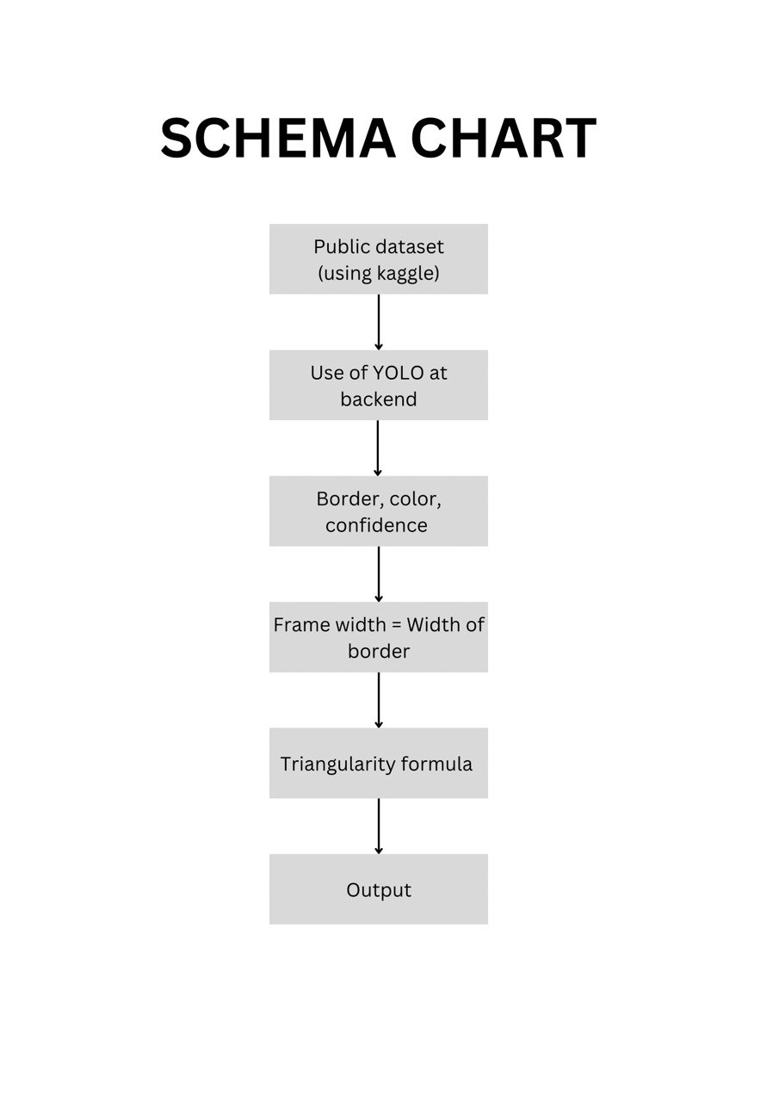

Slide 4
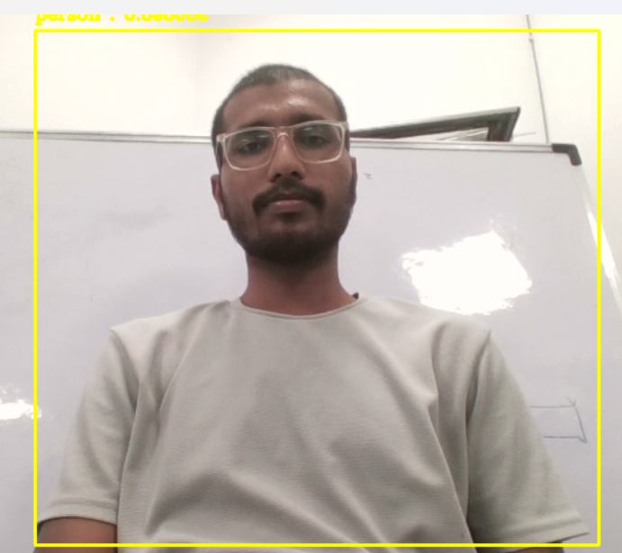
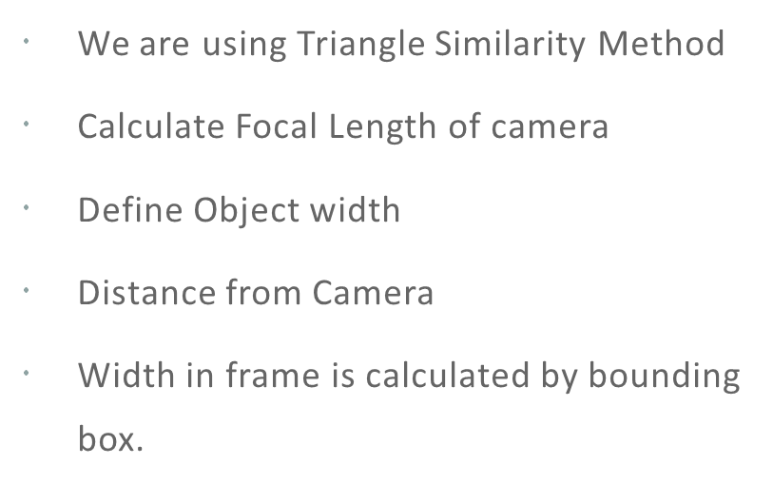
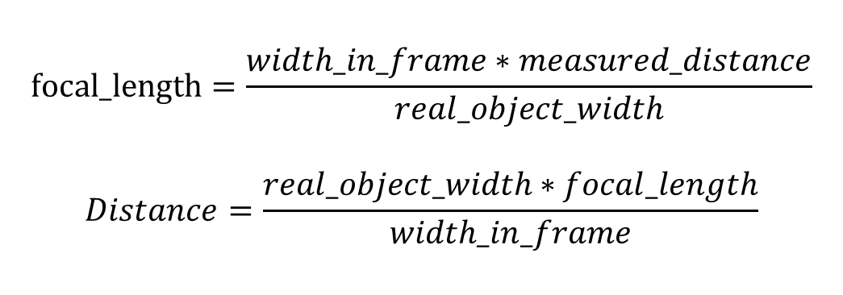
Working Principle:-
We are using Triangle Similarity Method
Calculate Focal Length of camera
Define Object width
Distance from Camera
Width in frame is calculated by bounding box.
$$focal_length=\frac{width_in_frame∗measured_distance}{real_object_width}$$
$$Distance=\frac{real_object_width∗focal_length}{width_in_frame}$$
Img-1: Bounding Box

Slide 5
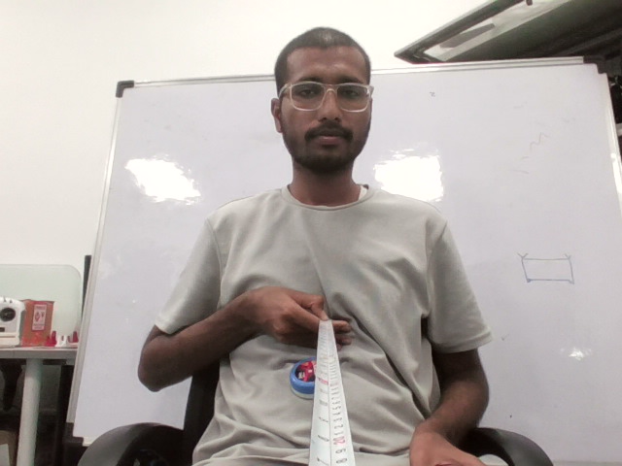
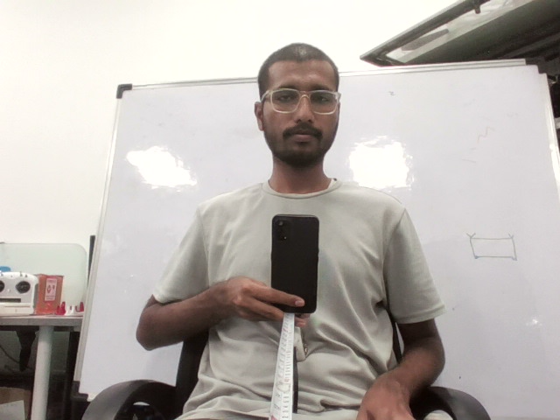
CALIBRATION IMAGES
Img-3: Mobile Calibration
Img-2: Person Calibration
Object | Distance (inch) | Width (inch)
Person | 31 | 20
Mobile Phone | 31 | 3

Slide 6
CODE EXPLAINATION

Slide 7
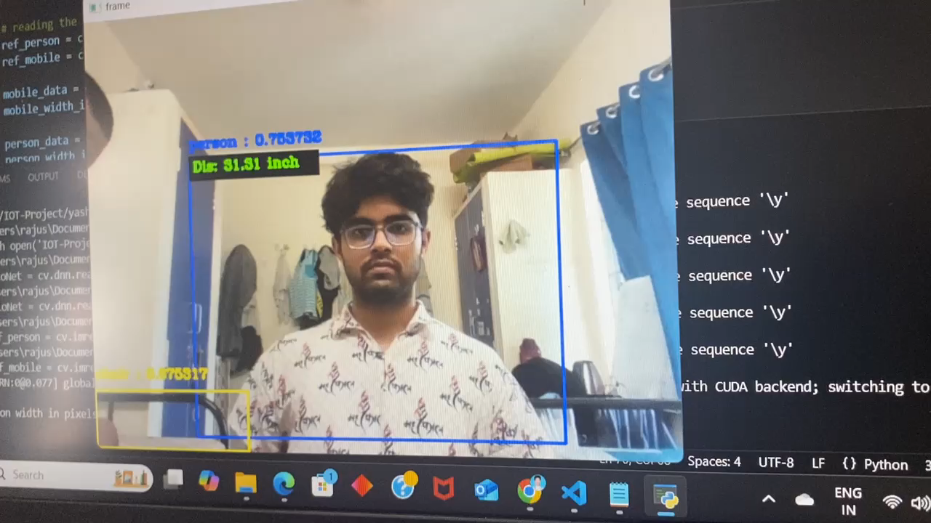
Results and Conclusion:
Distance estimation
Object Detection
Real-Time Distance (in) | Measured Distance (in) | Error Percentage (%)
24 | 23 | 4.16
30 | 29 | 3.33
40 | 38 | 5
50 | 52 | 3.84

Slide 8
Limitations & Future Works:
Object Size Variability
Dependence on Lighting Conditions
Limited Object Calibration
Camera Range and Field of View
Dynamic Object Detection
Class-specific Calibration

Slide 9
References:
The Analysis of the Effect of the Parameters on Indirect Distance Measurement using a Digital Camera, May 2019, DOI: 10.1109/MILTECHS.2019.8870101
Find distance from camera to object/marker using Python and OpenCV by Adrian Rosebrock
https://github.com/Asadullah-Dal17/Distance_measurement_using_single_camera

Slide 10


